Slide 1
Unit 2 Supervised Learning I- Linear regression- I
Simple Linear Regression
Multiple Linear Regression
Polynomial Regression
Ridge Regression
Lasso Regression

Slide 2
What is data modeling/model building : Use a suitable machine learning algorithm to build model
steps involved in training or building a model are :
Select suitable model technique (data mining technique)
Select the suitable algorithm
check accuracy of the model created using chosen algorithm
Compare accuracy of the models generated by different algorithms

Slide 3
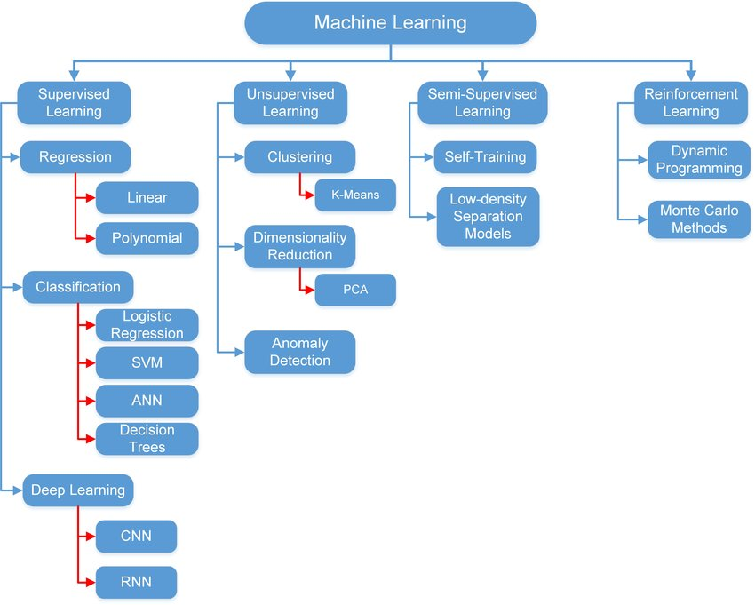

Slide 4
Supervised Machine Learning
Supervised Machine Learning
Regression
Classification
Simple Linear
Logistic Regression
Multiple Linear
Decision Tree Regression
Polynomial
Random Forest
Ridge Regression
Support Vector Machine
Lasso Regression

Slide 5
Regression
Regression is a method of modeling a target value based on independent predictors.
This method is mostly used for forecasting and finding out cause and effect relationship between variables.
Regression techniques mostly differ based on the number of independent variables and the type of relationship between the independent and dependent variables.

Slide 6
Independent variable
Independent variables are the ones that you include in the model to explain or predict changes in the dependent variable.
Independent variables are also known as predictors
On graphs, analysts place independent variables on the horizontal, or X, axis.
In machine learning, independent variables are known as features.
For example, in a politicians strength study, the independent variables
might be political party (categorical) and gender of politician(categorical)
For example, in a plant growth study, the independent variables might be soil moisture (continuous) and type of fertilizer (categorical).

Slide 7
Independent variable
Independent variables are the ones that you include in the model to explain or predict changes in the dependent variable.
Independent variables are also known as predictors
On graphs, analysts place independent variables on the horizontal, or X, axis.
In machine learning, independent variables are known as features.
For example, in a politicians strength study, the independent variables
might be political party (categorical) and gender of politician(categorical)
For example, in a plant growth study, the independent variables might be soil moisture (continuous) and type of fertilizer (categorical).

Slide 8
dependent variable
The dependent variable (DV) is what you want to use the model to explain or predict.
dependent variables are also known as response variable
On graphs, analysts place dependent variable on the vertical, or Y, axis.
For example, in a politicians strength (dependent variable) study, the independent variables might be political party (categorical) and gender of politician(categorical)
For example, in a plant growth (dependent variable)study, the independent variables might be soil moisture (continuous) and type of fertilizer (categorical).

Slide 9
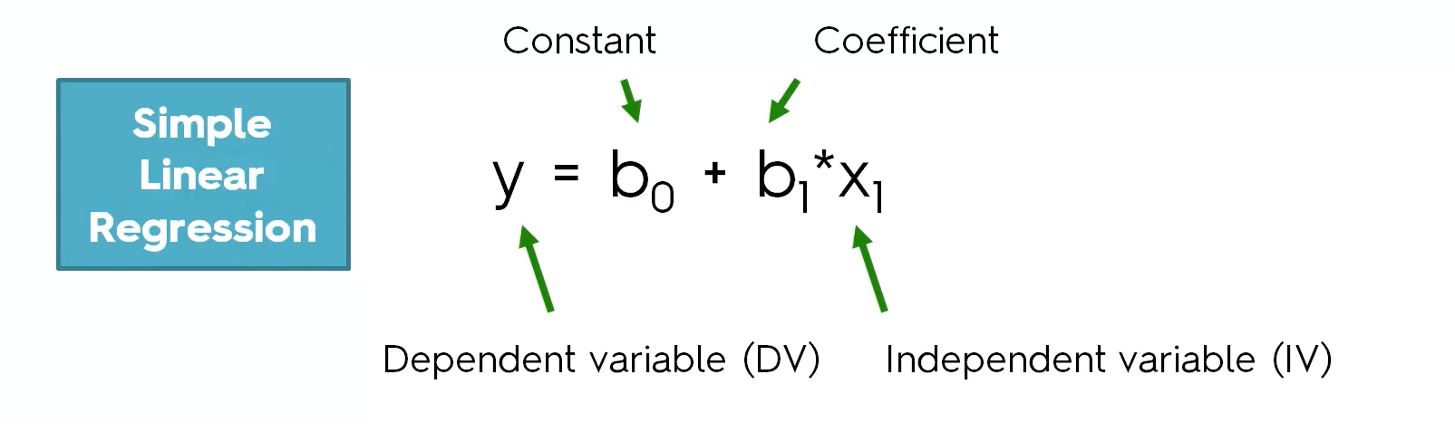
Simple Linear regression
Straight line regression analysis involves a response variable y and a single predictor variable x and models y is a linear function of x
where b0 (y-intercept) and b1 (slope) are regression coefficients
These coefficients can be solved by the method of least squares which estimates the best fitting straight line

Slide 10
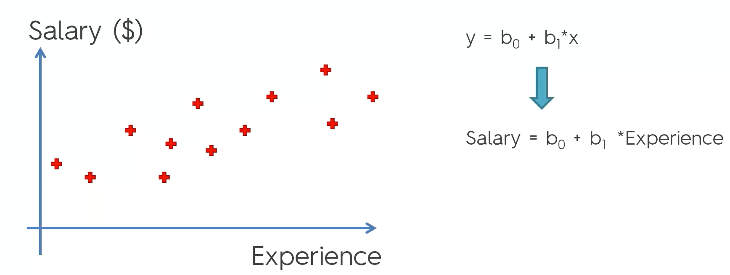
Example
30k

Slide 11
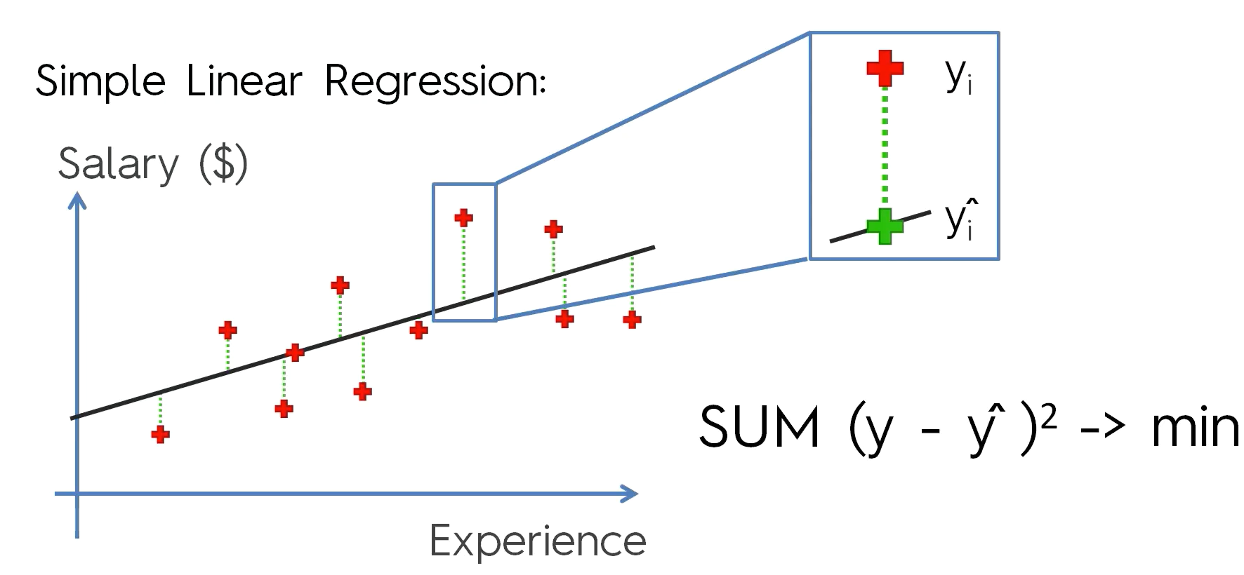
Method of least squares to estimate the best fitting line

